Slide 1





ISI HYD
RKMVERI
DECODING DEPARTURES: A CLASSIFICATION JOURNEY INTO CUSTOMER CHURN
A MACHINE LEARNING PERSPECTIVE
SOHAM PAUL – ANIRBAN DEY

Slide 2

CONTENT
01
Introduction
02
SOP
03
Data Prep & Cleaning
04
EDA
05
Feature Engineering
06
Modelling
07
Evaluation
08
Challenges
09
Future Work
10
Conclusion

Slide 3




INTRODUCTION
Customer churn is a critical issue for telecom companies, as it can lead to significant revenue loss and damage to the company's reputation. ABC Voice, a telecom company that has been in operation since 1999, is no exception to this challenge.
Customer churn can be defined as the rate at which customers stop using a company's services. For telecom companies, this typically means the number of customers who cancel their subscriptions or switch to another provider. There are many reasons like:
Dissatisfaction with the service
Better offers from competitors
Life changes

Slide 4













PROBLEM STATEMENT
ABC Voice is facing a growing challenge in retaining its telecom customers. With increasing competition and changing customer preferences, the company is experiencing a high rate of customer churn. The objective of this project is to develop a predictive model that can accurately identify customers at risk of churning. By doing so, ABC Voice aims to proactively implement customer retention strategies and reduce churn rates, ultimately improving customer satisfaction and the company's profitability. This project will leverage machine learning techniques to analyze historical customer data and build a predictive
model capable of identifying potential churners, enabling ABC Voice to take timely actions to retain these customers.
GOALS
BENEFITS
ENHANCED PROFITABILITY
PROACTIVE CHURN MANAGEMENT
COMPETITIVE ADVANTAGE
ENHANCED SERVICE QUALITY

Slide 5








DATA PREP & CLEAN
Data Collection
Collected Customer Churn Data containing info on all 7,043 customers from a Telecom company (say, ABC Voice) in California in Quarter 2 of 2022
Data Reduction
Dropped irrelevant columns from the dataset like Customer ID, Total Refunds, Zip Code, Latitude, Longitude, Churn Category & Churn Reason
Data Cleaning
Eliminated rows having Null Values for several columns. E.g., in ’Avg Monthly GB Download’ column, 21.6% of the data instances contain NULL values
Data Categorization
Categorized columns in Attributes, Discrete Variables & Continuous Variables for Analysis purpose

Slide 6




EXPLORATORY DATA ANALYSIS
Exploratory Data Analysis (EDA) and data visualization provide a comprehensive understanding of the dataset by revealing hidden patterns and relationships. They aid in identifying factors contributing to customer churn and guide feature selection. Histograms and box plots for continuous variables highlight data differences between churned and non-churned customers. Bar plots for categorical variables offer insights into factors influencing churn, enabling targeted retention strategies. Additionally, data visualization simplifies complex information, facilitating data-driven decisions and improving customer satisfaction.

Slide 7
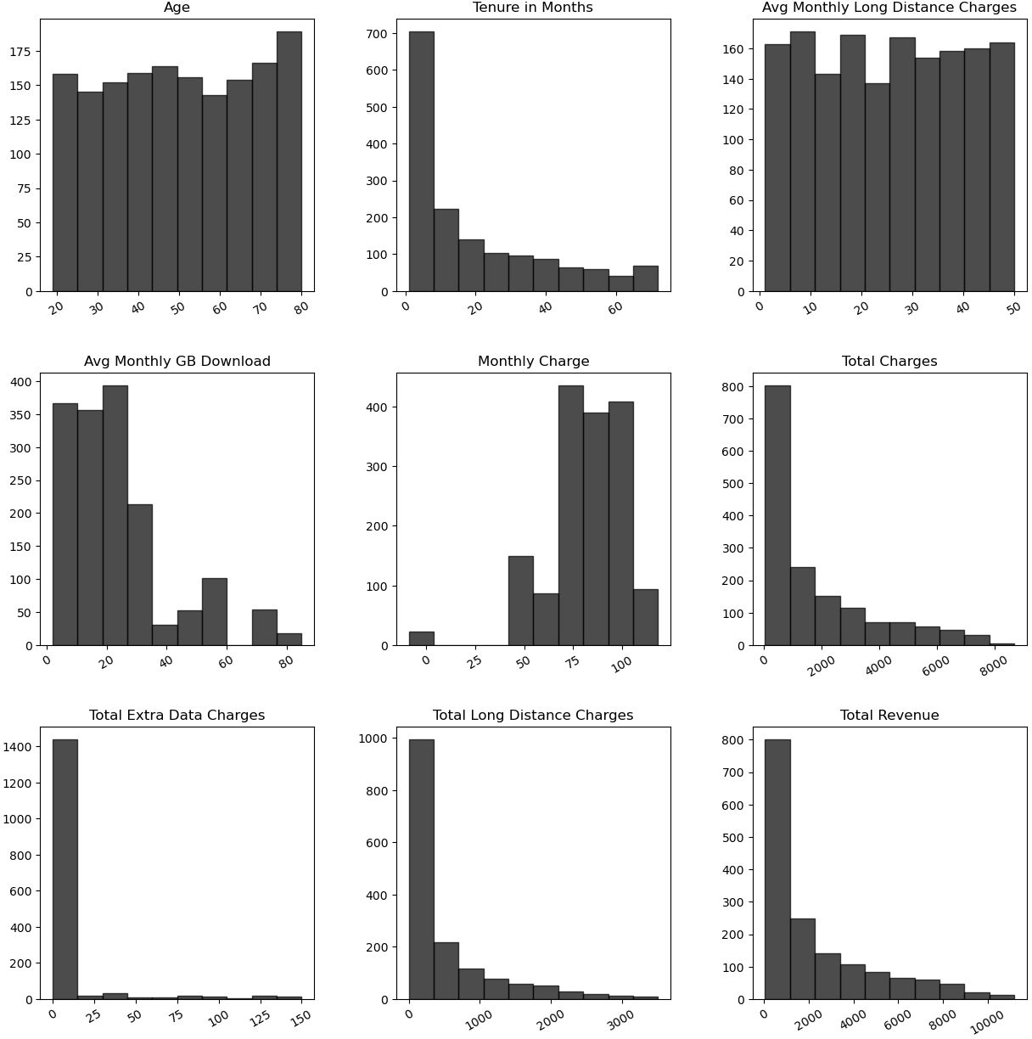



HISTOGRAM OF DISTRIBUTION OF CHURNED CUSTOMERS
Customers in their late 80s & customers with shorter tenure have high churn; But different levels of avg monthly long distance charges has no effect on churn.
The customers with lower data usage, higher monthly charges & lower total charges have a higher churn rate.
The customers with lower extra data charges, lower long distance charges & lower revenue are more likely to churn

Slide 8
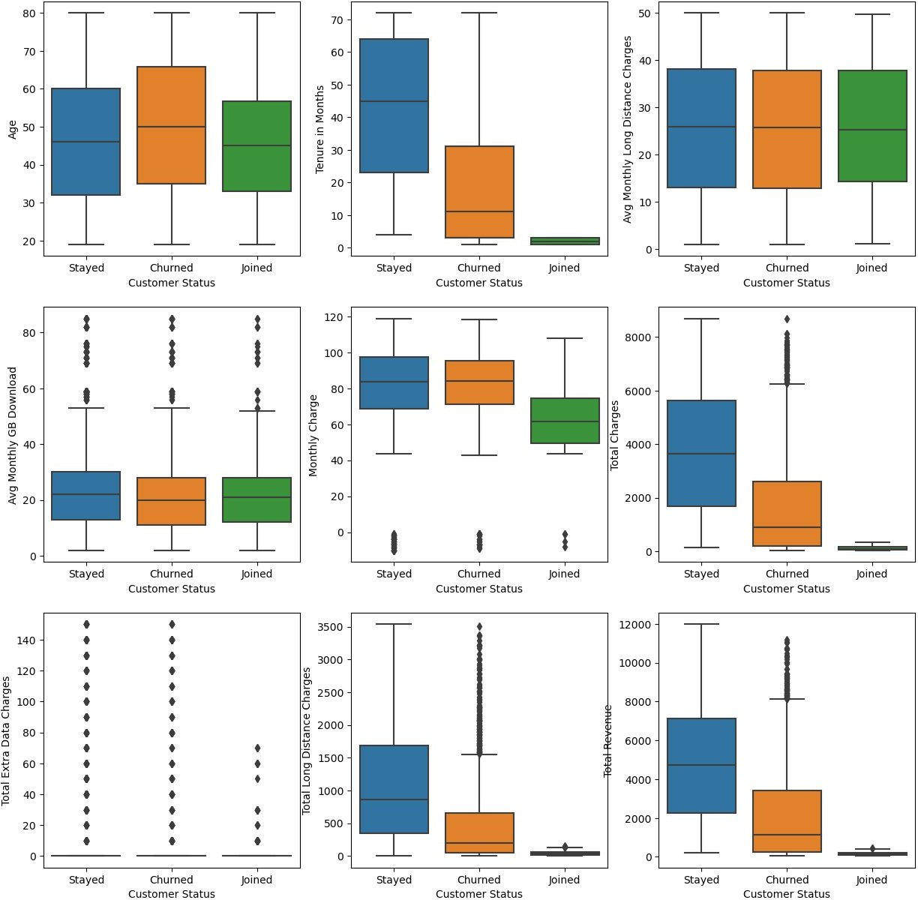
BOX PLOT OF CUSTOMER DISTRIBUTION
Joined customers are generally younger than others; the stayed ones have a longer tenure; But the distribution of average monthly long distance charges has no effect on churn
All types of customers have same data usage; joined customers have lower monthly charges; and for the churned customers, the overall total charges are less but some of them have unusual high charges.
All customers tend to have unusual observations for extra data charges; many of the churned customers have unusually high long distance charges; and stayed customers generate higher revenue.

Slide 9
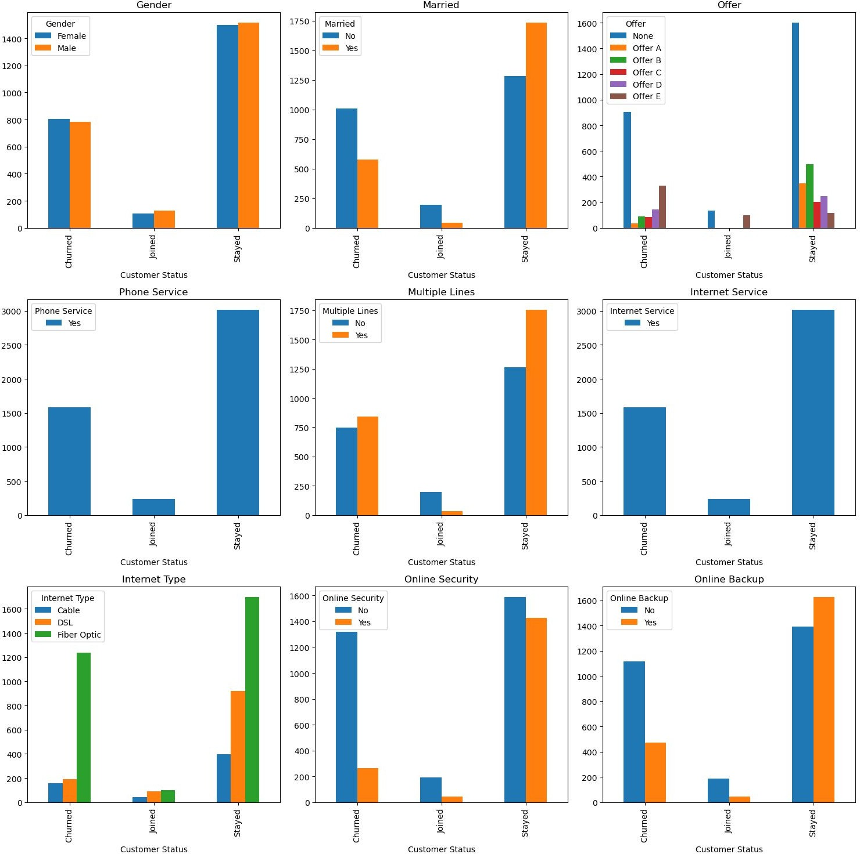
BAR PLOT OF CUSOMER DISTRIBUTION ON DIFFERENT ATTRIBUTES
Gender distribution for all are almost same; married customers are more likely to stay; and certain offers might be more associated with churned or joined customers.
All types of customers have same phone service & same internet service; but a single line have a higher join rate.
Certain statuses are more likely to churn or join; but customers not getting online security & online backup has high churn rate.

Slide 10
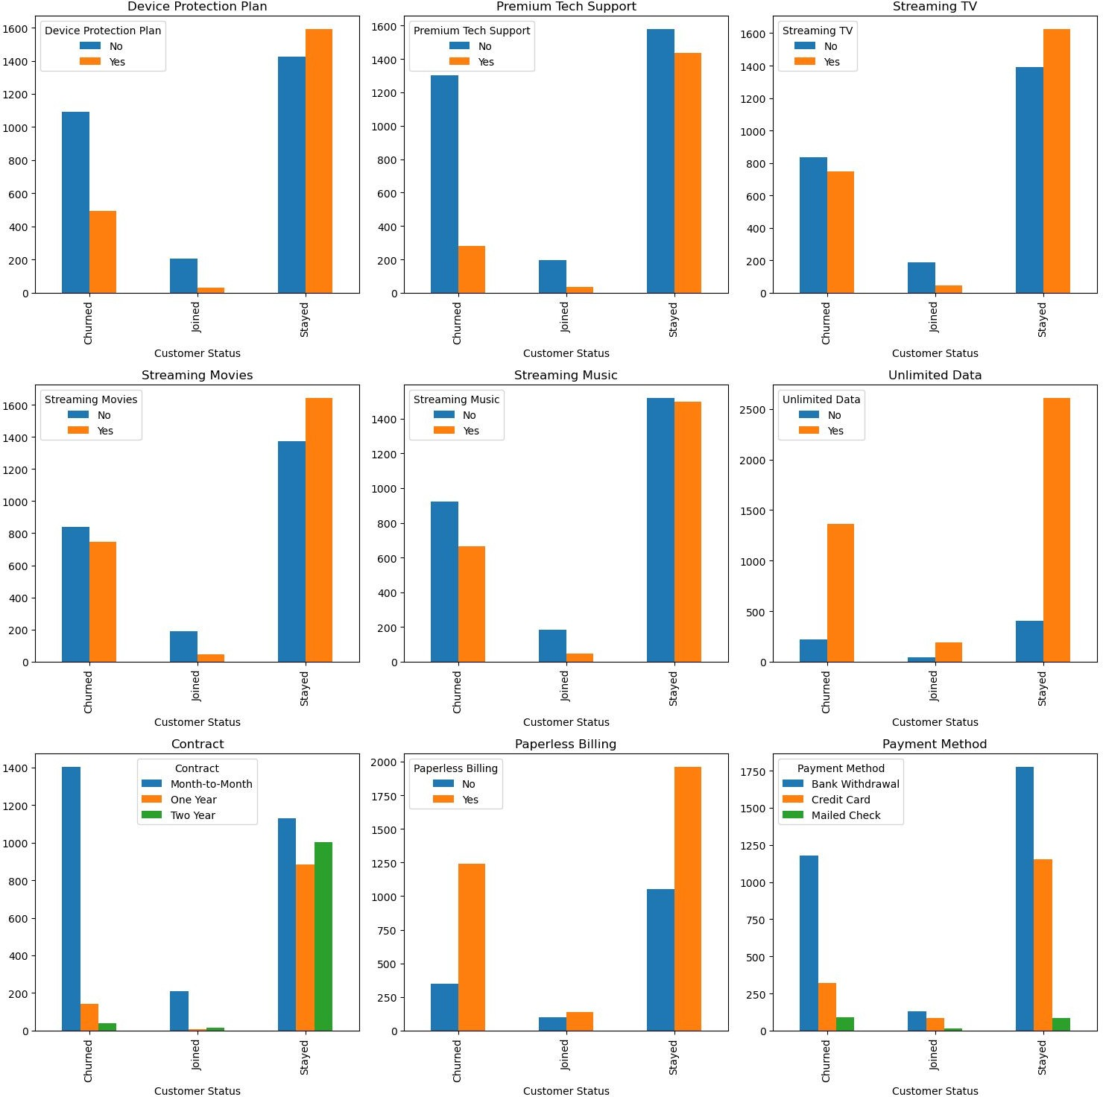
BAR PLOT OF CUSOMER DISTRIBUTION ON DIFFERENT ATTRIBUTES
Customers without a device protection plan and without premium tech support are more likely to churn
Customers who have streaming TV, Movies, Music & unlimited data are more likely to stay.
Customers with a yearly contract have less churn rate; paperless billings have no effects on churn rate; and customers using credit card & mailed cheques are rare to churn.

Slide 11




FEATURE ENGINEERING
Key steps include feature encoding for categorical variables, label encoding to convert labels to numerical format, dummy variable introduction for binary representation, feature scaling for magnitude uniformity and train-test splitting for model evaluation on unseen data.
Feature Encoding
Label Encoding
Gender values, Paperless Billing, Unlimited Data Usage, Movies- Music- TV Streaming, Premium Tech Support, Device Protection Plan, Online Backup & Security, Multiple Lines, Marital Status are converted into numerical representations
Dummy Introducing
Customer statuses ( Churned, Joined & Stayed) are encoded into numerical representations, (0,1,2) facilitating the incorporation of this information into machine learning models.
Feature Scaling
Dummy variable is introduced for some columns like Payment Method, Contract, Internet Type, Offer & City
Data Splitting
Dependents, age, referrals, tenure, monthly charges etc. columns are scaled by normalization
80-20 Split for Train & Test

Slide 12









Random Forest
Naïve Bayes
The Naive Bayes algorithm employs Bayes' theorem and assumes feature independence given the churn status. It calculates the probability of a customer churning based on observed features, considering the prior probability of churn and individual feature probabilities.
SVM
SVM for three-class churn classification uses "one-vs-one" or "one-vs-the-rest," creating binary classifiers for class pairs or treating each class individually. Trained on labeled data with features reflecting customer behavior, SVM seeks decision boundaries maximizing class separation.
Random Forest for a three-class churn classification involves using an ensemble of decision trees to predict whether customers will Stay, Churn or Join.
Features like usage patterns, complaints, and customer behavior are considered in the training process.
MODELLING
Logistic Regression
Logistic regression is employed by assembling a dataset with numerically encoded labels and utilizing the 'multinomial' option for multiclass classification. The interpretability of logistic regression allows for understanding the impact of individual features on the likelihood of churn, as indicated by the model's coefficients.
Decision Tree
Decision Tree recursively splits the dataset based on features to create a tree-like structure. Each leaf node represents a class .Decision Tree, the algorithm recursively splits the dataset into Stayed, Churned or Joined based on features to create a tree-like structure. Each leaf node represents a class.
XGBoost
XGBoost is applied to a three-class churn classification by first preparing a dataset with relevant features and numerically encoding the class labels. The XGBoost algorithm, known for its ensemble of decision trees, is then employed to learn the patterns in the data.

Slide 13


CONFUSION MATRIX
Logistic Reg
Naïve Bayes
Decision Tree
Random Forest
XGBoost
SVM
244 | 4 | 100
18 | 13 | 19
73 | 0 | 496
169 | 92 | 87
18 | 15 | 17
359 | 64 | 146
214 | 22 | 112
30 | 20 | 0
71 | 0 | 498
219 | 0 | 129
40 | 9 | 1
28 | 0 | 541
231 | 0 | 107
25 | 25 | 0
38 | 0 | 531
241 | 0 | 107
32 | 0 | 18
62 | 0 | 507

Slide 14
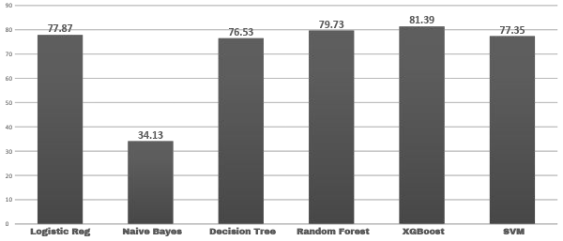
ACCURACY EVALUATION
ACCURACY PERCENTAGE

Slide 15



CHALLENGES
Inaccuracies, missing values or outdated information can compromise the model's accuracy and reliability. Also, no real life data follows any particular distribution; so modelling on that dataset may violate model assumptions.
Selecting relevant features is crucial for accurate predictions. Understanding the business domain and identifying meaningful features can be highly challenging.
Striking the right balance to prevent overfitting or underfitting of models is challenging. Proper model tuning and regularization techniques are necessary to achieve optimal performance on unseen data.
Interpreting complex models for stakeholders can be challenging. In industries where decisions impact customer relationships, explaining predictions is crucial for gaining trust and acceptance.

Slide 16





FUTURE WORK
Future works involve refining feature engineering, optimizing model hyperparameters, exploring advanced techniques like ensemble methods & deep learning and fostering collaboration with business stakeholders for continuous model improvement aligned with strategic goals. Ethical considerations, bias assessment and user-friendly interfaces are also essential aspects to address in the evolving landscape of customer behavior prediction.
Handling Imbalanced Data
Business Strategy Integration
Cost Benefit Analysis
Implement techniques to address class imbalance in the dataset, especially if the occurrence of churn is
Collaborate closely with business stakeholders to align the model's predictions with actionable strategies for
Conduct a thorough cost-benefit analysis to
understand the economic impact of implementing
significantly lower than retention.
customer retention and engagement.
churn prevention strategies based on the model's predictions.

Slide 17
CONCLUSION
The work conclusively empowers businesses with actionable insights, derived from machine learning models, to strategically mitigate customer churn and foster sustained growth.
Empowering Decision-Making
Business Impact
Actionable Insights

Slide 18






OUR TEAM
Soham Paul
2nd Year MS-QMS Student
Indian Statistical Institute, Hyderabad
+91 93303 87993
in
soham-paul-96889019b
Hyderabad, India
Anirban Dey
2nd Year MSc BDA Student
RKM Vivekananda Educational & Research Institute
+91 91635 68623
in
anirban-dey-26b081260
Kolkata, India

Slide 19









ISI HYD
RKMVERI
THANK'S FOR WATCHING

